Slide 1


WILDFIRE MONITORING &
DETECTION SYSTEM
Team Name: ABC
Team Leader: ABC
Team Members:
Member 1
Member 2
Member 3
Member 4
Member 5
MADAN MOHAN MALAVIYA UNIVERSITY OF TECHNOLOGY,
GORAKHPUR, UTTAR PRADESH, INDIA

Slide 2

INTRODUCTION
Forest plays an important role for supporting human life.
Forest ecosystem is habitat to large number of animals, plants and microbes.
64 Mha out of 328 Mha geographical area of India are under forest.
Wild Fire occurs either by natural fire or man-made fire.
It damages natural resources , environment and human lives.
“The forest is not a resource for us, it is life itself.
It is the only place for us to live.”
-Evaristo Nugkuag Ikanan

Slide 3
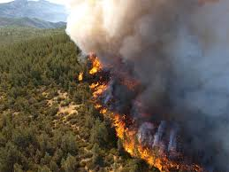
MOTIVATION
Wild fire damaged 20 million acres (estimated) in Australia. And economic losses exceeded to hundred billion dollar (sept 2019 to 2020).
In 2018, 8.8 million acres burned in California caused $16.5 billion in damages.
Forest burned 906,000 hectares (2,240,000 acres) due to Amazon Wild Fire, average of 1.2 million acres U.S. woodland burn every year.
Bandipur ,Karnataka burned area 4,419.54 hectare(10,920 acres) on Feb 2019.
About 21.40% forest cover in India is prone to fires.
Pre-existing monitoring and detection systems are either using Sensors or Drone for Detection.
So both the techniques are integrated together for monitoring and detection followed by machine learning to increase the preciseness.

Slide 4
PROPOSED IDEA /SOLUTION
The main idea behind this proposal is to detect the fire in forest areas. The objectives are sub-classified into following modules:
The Sensing Module.
Raspberry-Pi micro-controller based Monitoring Unit
GSM module to alert the sub-station and collect the data on cloud.
The Drone Monitoring Module.
Capturing of Images from fire prone area.
Sending co-ordinates and images on cloud using OpenCV.
Fire detection, analysis and alert system.
Analysis of images using machine learning algorithm.
Detection of fire and taking necessary actions.

Slide 5
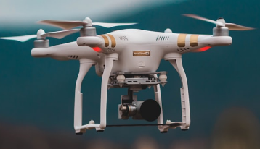
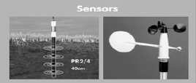
Architecture of Forest Fire Detection System
Cloud
MONITORING STATION
Data Analyzing and Detection Unit.
Alert Systems
Raspberry-Pi

Slide 6
BLOCK DIAGRAM
Start
Sensor and Monitoring Unit
Data
collection
Monitoring Sub-station
Cloud Layer
Inspection
Area
Data
Verification and processing
UAV
Image Detection
Local Units
Local Units
Local Units

Slide 7
Proposed Modules
Modules | Description
Sensor and Monitoring unit | Soil Moisture and soil temperature sensors, Infrared sensor, Wind direction and speed sensor (Anemometer), GPS. The data from the sensors is continuously sent to the cloud.
Drone Module | Drone Architecture consist with Fire watch optical sensor, obstacle avoidance(LIDAR sensor), gyroscope, GPS, magnetometer, range finder, inertial measurement unit , gas and smoke sensor, Compass.
Data Analysis and visualization | Here Image processing is done on captured image using Open CV, analysis is done using ML Techniques.
Alert System | If fire is detected then alert to nearby control station.

Slide 8
SENSOR AND MONITORING UNIT
Sensor and monitoring unit comprises of various heavy duty sensors which is going to sense and measure various parameters such as soil moisture & its temperature, air pressure and wind speed and its direction etc.
Sensor system is going to installed in different section of forest and we’ll integrate this sensor system through Raspberry-pi.
The section will be made according to the range of sensors.
It will collect the real time data of that section of forest and will send it to the cloud; further the data is going to be compared with already stored threshold value, which is responsible for forest fire.
If the sensed value is more than threshold value, then it will send the signal to local station (monitoring unit) to activate the drone.

Slide 9
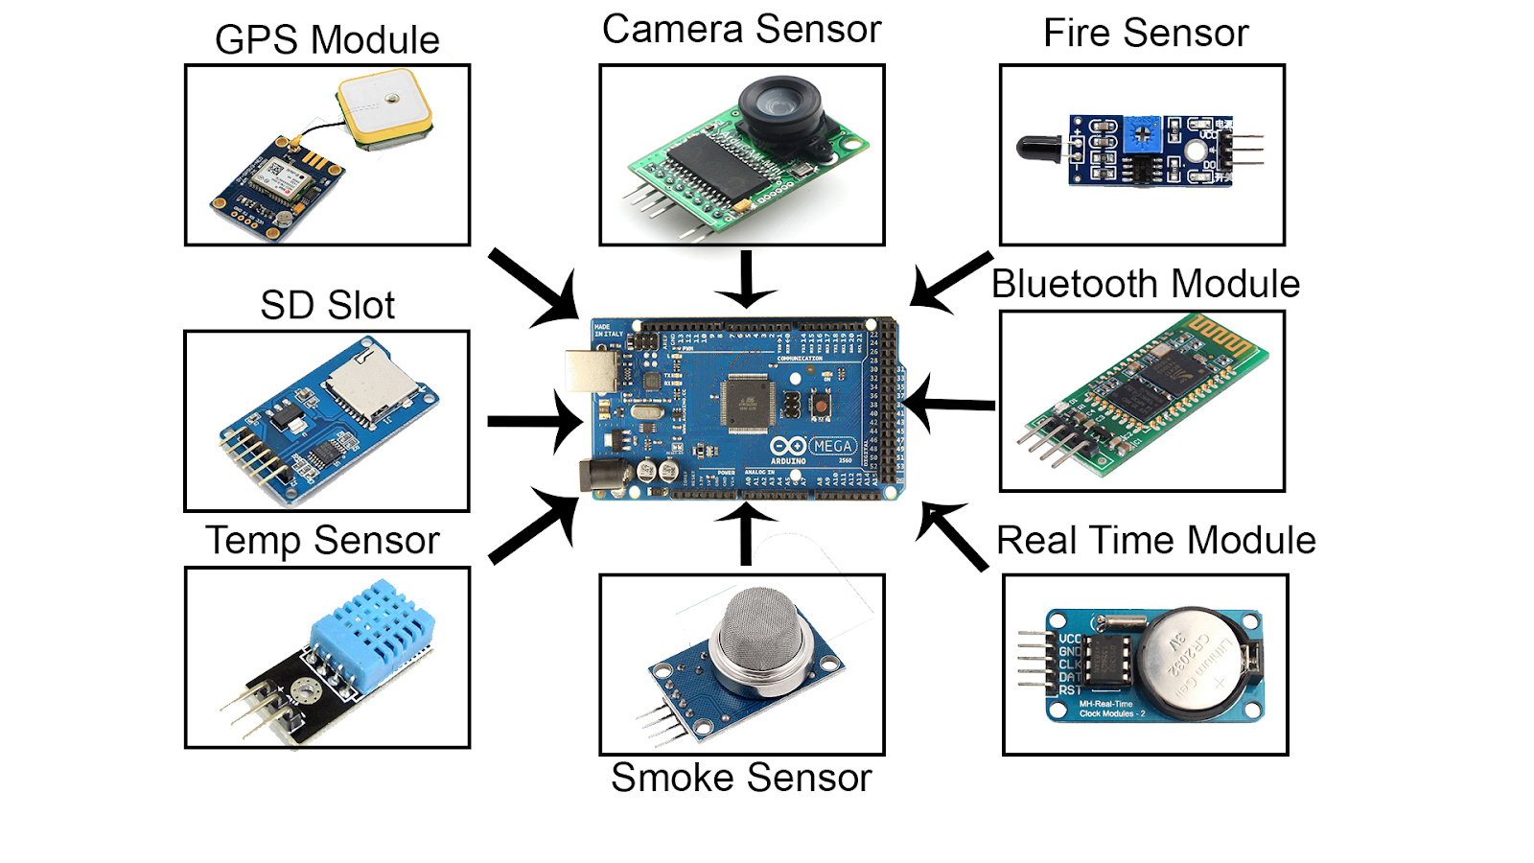

Slide 10
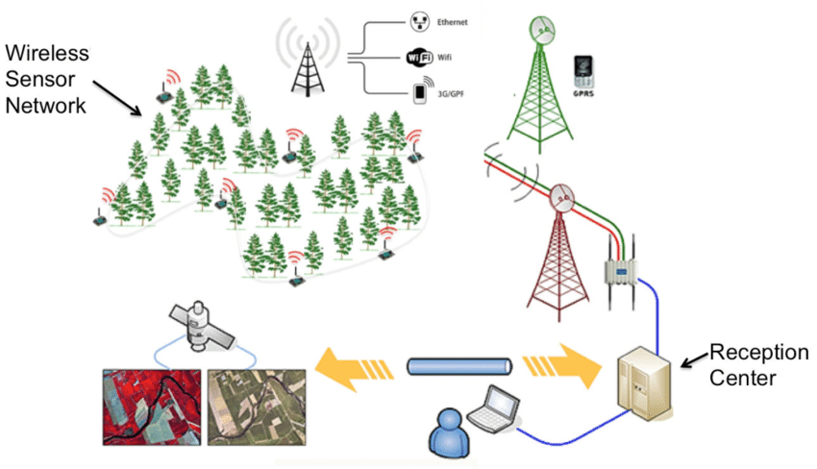

Slide 11
MONITORING SUBSTATION
This unit will work as local sub station for a particular number of section of forest altogether.
All the data that has been stored on cloud will be displayed in this unit and compared with threshold values .
Here the part of manual checking and false alarm verification is done, if undesirable conditions are observed then this unit will activate drone for inspection of a particular section.
This section is also responsible for informing and sending alert to local substation such as hospital, fire station and nearest police station.

Slide 12
DRONE/UAV MODEL
The drone structure has to withstand in tough and high temperature condition, hence Aramid and basalt fiber will be used as body of drone.
It has Lidar sensor to measure the distance and sense the object which will keep our drone safe while navigation through obstacles surrounding to this.
The drone module will also help us tackling the false alarm by having gas and smoke sensor and image detection.
This detected image will further send to cloud with coordinate location & direction because of inbuilt GPS and compass in drone.

Slide 13
CLOUD LAYER
It consists two blocks-
1. Data collection- A cloud drive is used in this section, which could be service such as AWS, AZURE, Google cloud to a name few. Here the data is collected from sensor and drone.
2. Data verification & processing- Here received data (from sensor unit) is compared with a threshold value which can be done using short line of code. When the value is above threshold, it will send data to monitoring station, with coordinate axis of that location using GPS.
It will also receive the captured image of that location (taken by UAV), and will compare it with trained model using Machine Learning Algorithm for example fire detection algo, in which there are some fire classifiers are used to know the places where there is fire and will report an alarm which can help us in early detection of wildfire and prevention measures can be taken.

Slide 14
CONCLUSION
To protect the ecosystem, human and animal’s life is the prime goal.
The rapid growth in wild fires leads to losses of life, property and economy.
It affects food supply, health care sector and business.
Billions of animals killed in this disaster.
Forest fire caused loss of water, habitat , food for animals left them burned, dehydrated and malnourished.
This system not only detect the possible conditions of fire but also provides the alert in the real time.
There is huge scope in different sectors to detect the unwanted fires with the help of Unmanned Aerial Vehicle (UAV).
Fire alert system will not only send alert but also provides help in Fire Management.

Slide 15
REFERENCES
R. K. Ramasamy, F. F. Chua, and G. Y. Chan, “Cloud-Based Early Warning System for Forest Fire using IoT Techniques,” Knowledge Management International Conference (KMICe), 25–27 July 2018, Miri Sarawak, Malaysia, pp.101-106
Mark Crowley, Adaptation Through Learning: Using Machine Learning to Improve Forest Wildfire Management.
Jun Hong Park et. al., Dependable Fire Detection System with Multifunctional Artificial Intelligence Framework
www.thehindu.com/sci-tech/energy-and-environment/one-fifth-of-countrys-forests-prone-to-fires-study/article30446295.ece
www.accuweather.com/en/business/australia-wildfire-economic-damages-and-losses-to-reach-110-billion/657235
www.thebalance.com/wildfires-economic-impact-4160764
www.nasa.gov/topics/earth/features/wildfires.html
www.images.indianexpress.com/2020/01/australia-8.jpg

Slide 16
THANK YOU

